Slide 1



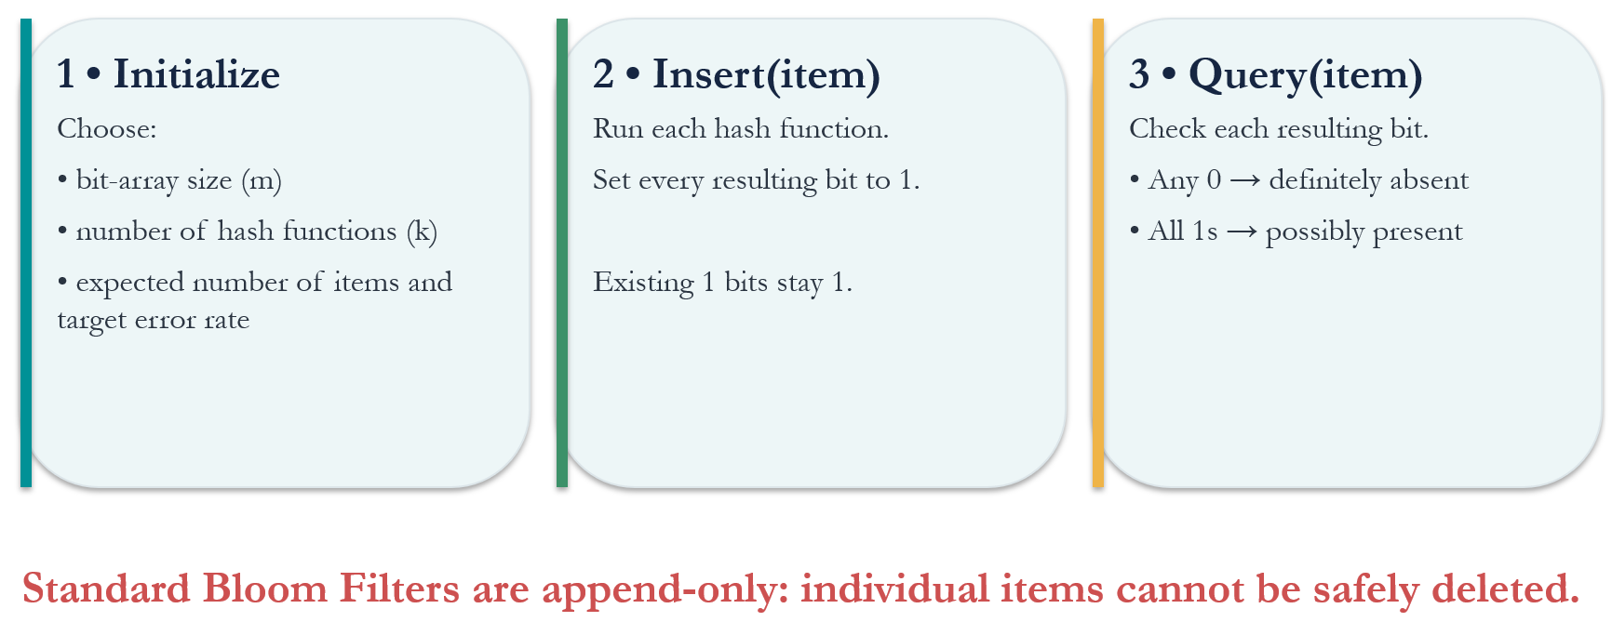
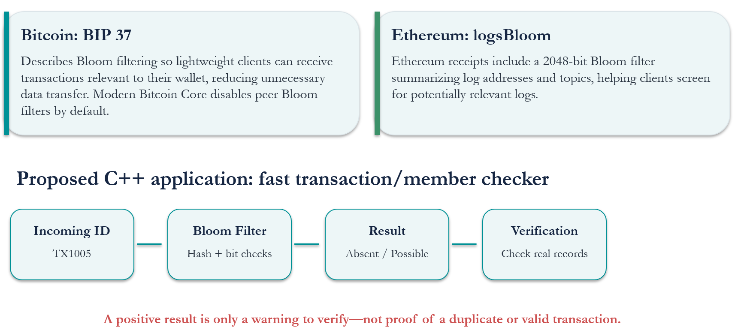
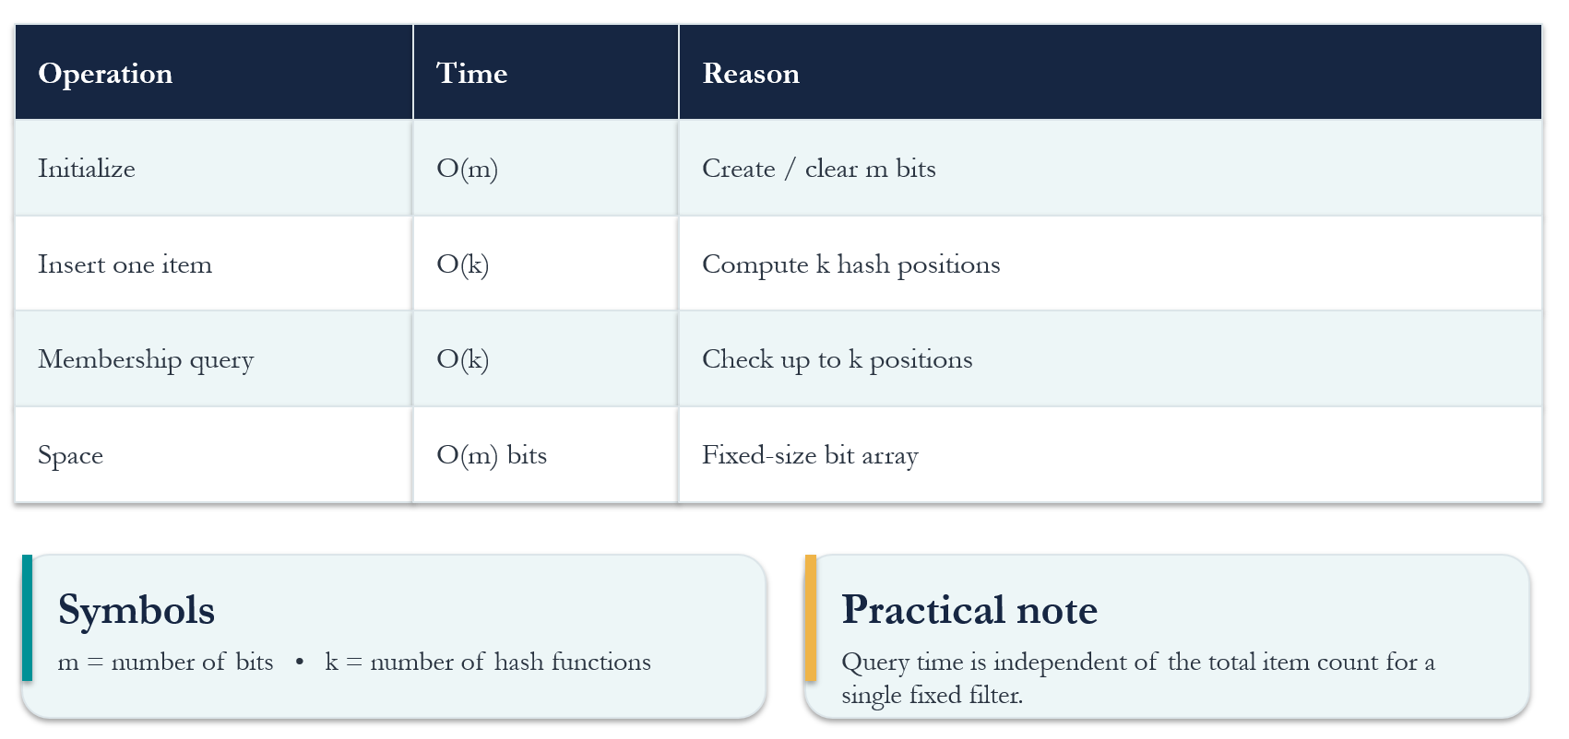
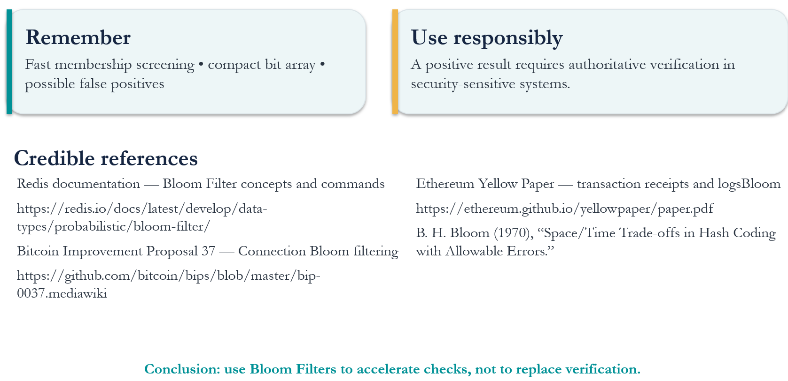
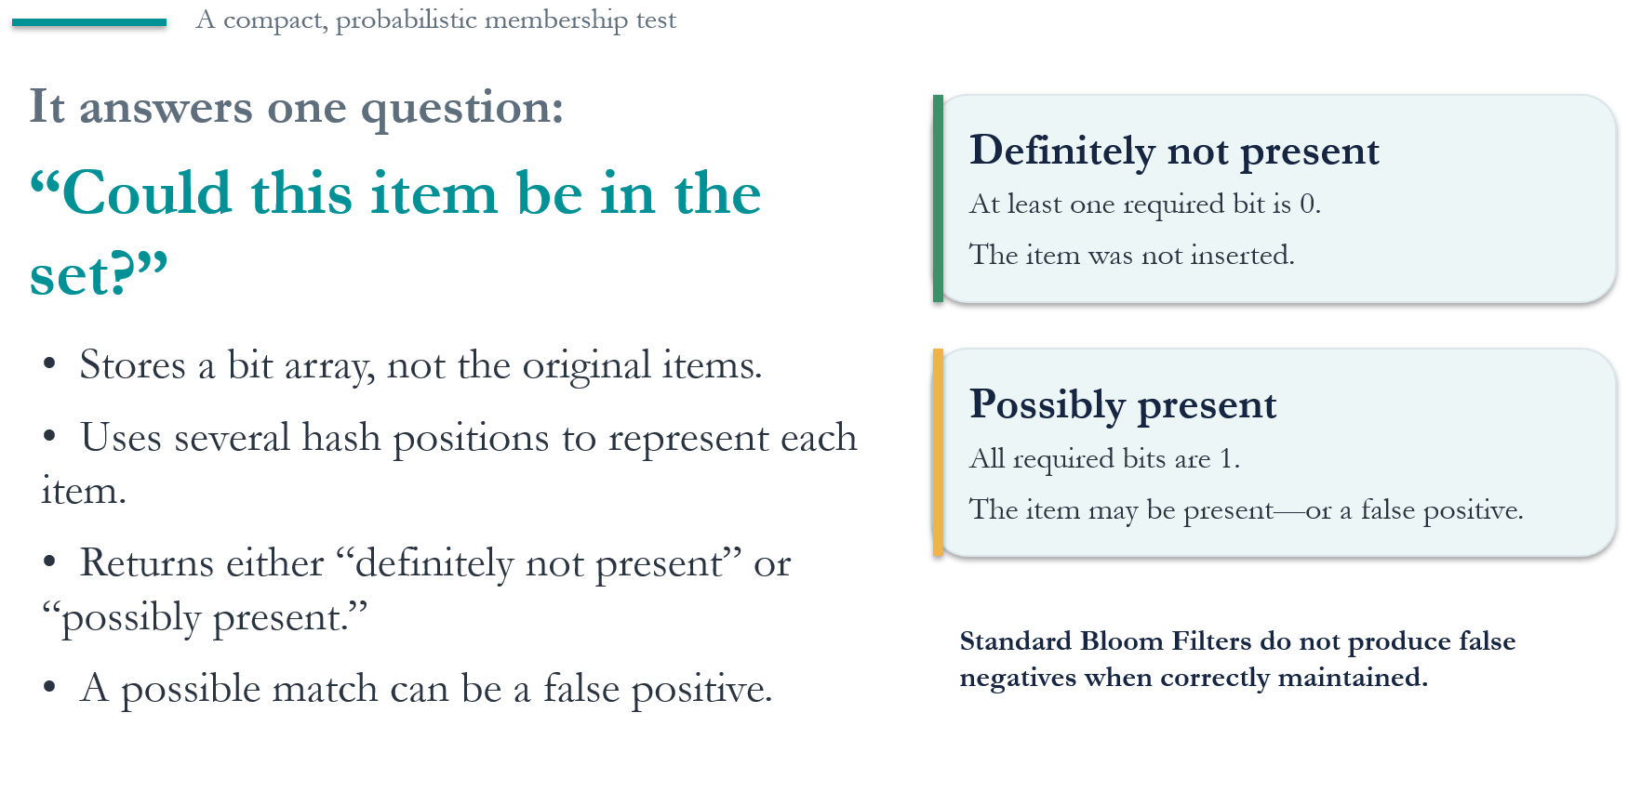
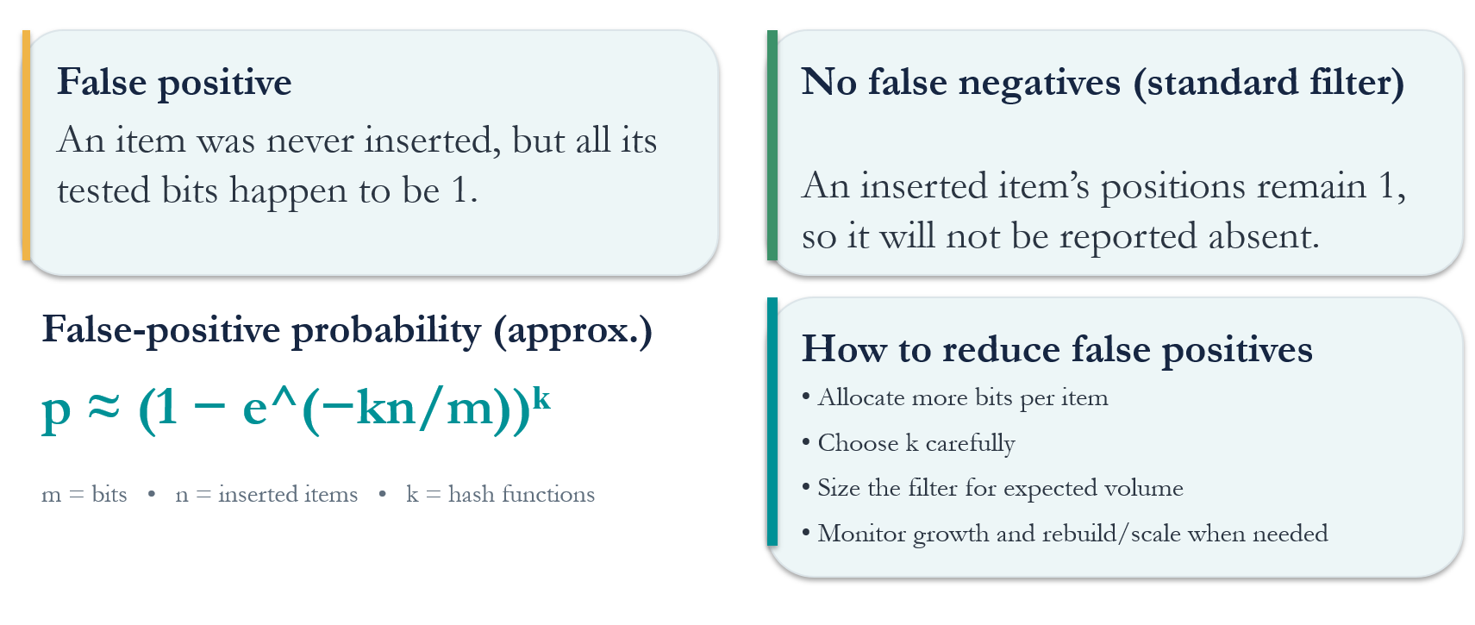
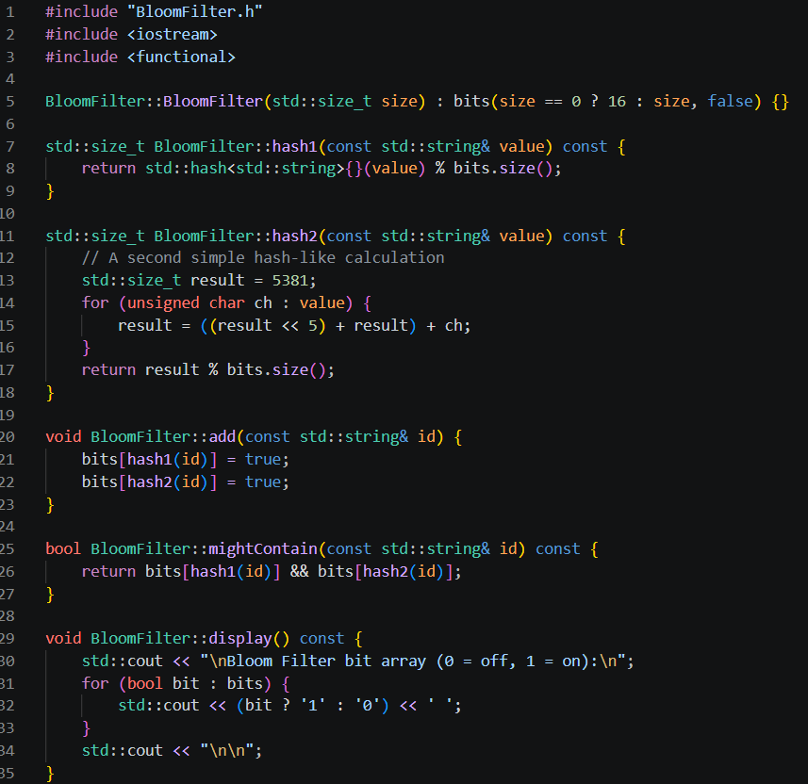
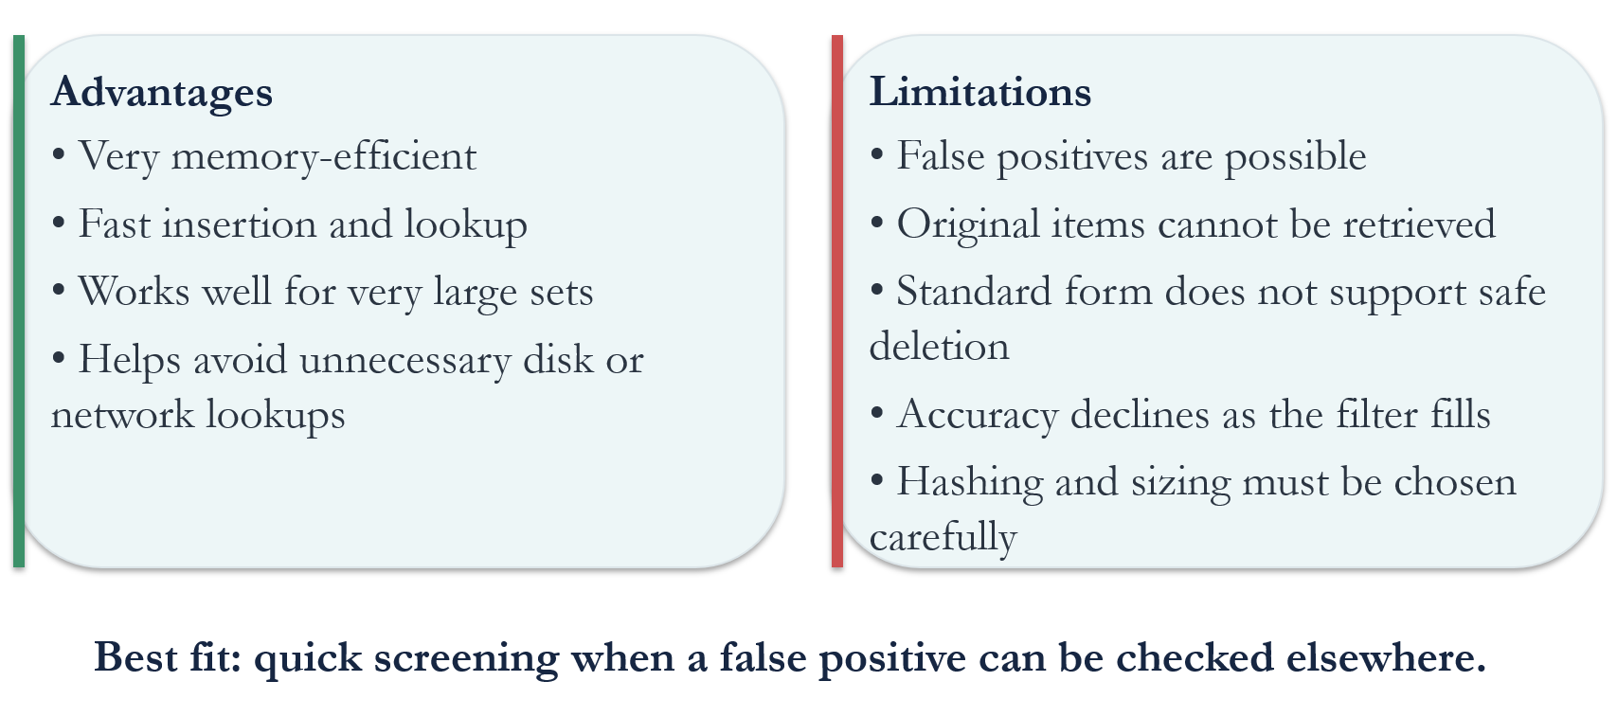
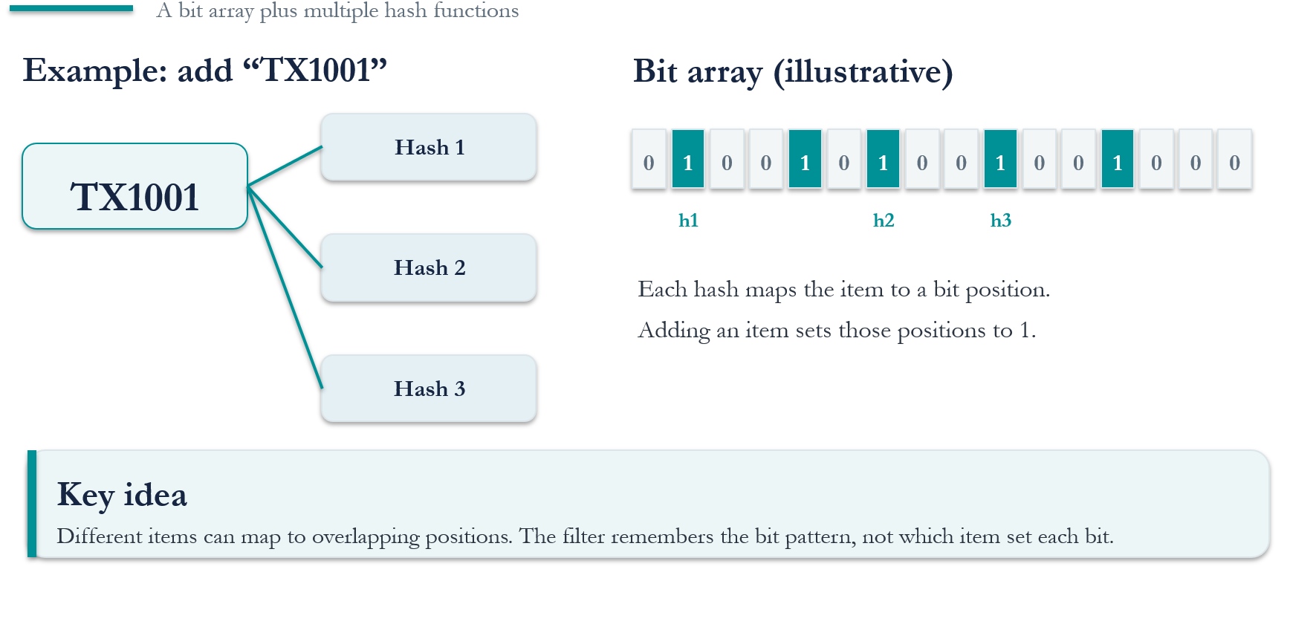
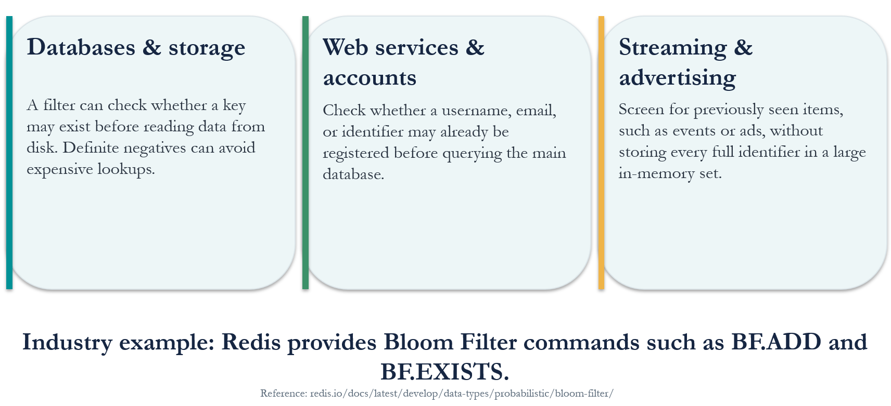
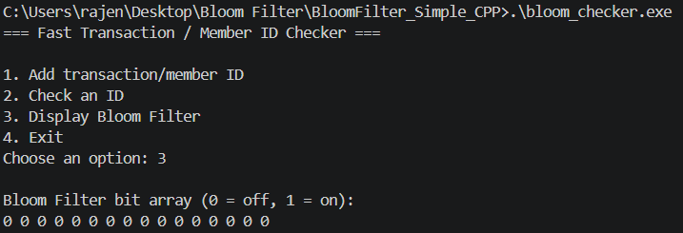



Fast Transaction/Member Checker Using
a Bloom Filter
Rajendra Prasad Joshi
Faculty Advisor: Dr. Victor Govindaswamy
Concordia University Chicago
Abstract
Future Functionality Enhancements
Major Operations
Cybersecurity and Blockchain
This project presents the design and implementation of a Fast Transaction/Member Checker developed in C++ to demonstrate the practical use of a Bloom Filter, a space-efficient data structure used for fast membership checking. The primary goal of the application is to show how transaction or member IDs can be checked efficiently while using a small amount of memory.
The application provides a simple, menu-based interface that allows users to add transaction or member IDs, check whether an ID might exist in the filter, and display the current state of the Bloom Filter as a bit array. The program uses hash functions to map each ID to specific positions in the bit array. When checking an ID, the application determines whether it is definitely absent or might be present. Since Bloom Filters can produce false positives, a possible match does not guarantee that the ID actually exists.
The system is developed using fundamental C++ concepts, including classes, member functions, vectors, conditional statements, loops, and input validation. The BloomFilter class manages the bit array and implements the operations for adding, checking, and displaying IDs, while the main program handles the menu and user interaction. This modular structure keeps the application simple and makes the data structure easier to understand and demonstrate.
This project demonstrates how Bloom Filters can help improve the efficiency of membership checks in applications that process large amounts of data. It also introduces the importance of probabilistic data structures in areas such as databases, distributed systems, blockchain, and cybersecurity. Through this implementation, the project highlights the balance between speed, memory usage, and accuracy when selecting data structures for real-world problems.
Future enhancements could include connecting the application to a database to verify IDs that the Bloom Filter identifies as possible matches. The program could also support configurable bit-array sizes, additional hash functions, and measurements of false-positive rates to demonstrate how these choices affect performance. Further development could explore blockchain-related applications, such as screening transaction records or event logs before performing more detailed checks. A graphical user interface, persistent data storage, and more advanced testing could also be introduced to make the application more practical while retaining its primary purpose as an educational demonstration of Bloom Filters.
Time Complexity and Space
Key Takeaways and References
What is Bloom Filter
Accuracy: False positive and tuning
Code
Advantages, Limits and Best fit
How the data is organized?
Real-world Applications
Technologies Used
Output

